Slide 1
Chapters 6 & 7
SQL Query Language

Slide 2
SQL Query Language
SELECT [DISTINCT] items
attribute names whose values are to be retrieved by the query
FROM tables
list of the relation names required to process the query
[WHERE conditions]
conditions on tuples
[GROUP BY columns]
for min, max, count, total, average on groups
[HAVING condition]
conditions on grouping
[ORDER BY columns]
sorting the result DESC|ASC

Slide 3
Sample Database
Student
S# | SNAME | AGE
1000 | John | 25
2000 | Kate | 24
3000 | Tony | 20
Grade
S# | C# | MARK
1000 | CS300 | 90
1000 | CS305 | 85
1000 | MT230 | 85
2000 | CS300 | 95
2000 | CS305 | 90
3000 | CS300 | 80
3000 | CS305 | 85
Course
C# | CNAME | LOC
CS300 | OS | ME300
CS305 | DB | UC231
MT230 | AL | TB300
List the student names for students taking all courses that Kate takes
List the student names for students taking only the courses that Kate takes

Slide 4
SQL Query Language
16. List the student names for students taking all courses that Kate takes
{S1.sname | S1 in student and S1.sname != 'Kate' and
(exists S in student)(S.sname = 'Kate' and
(forall C in course
(exists G in grade, G1 in Grade )
(S.S#=G.S# and G.C#=C.C# and S1.S#=G1.S# and G1.C#=C.C#)
or
(not exists G in grade)(S.S#=G.S# and G.C#=C.C#))}
S1 for seeked students and S is for Kate
If Kate takes it, then S’ also takes it
Kate does not takes

Slide 5
SQL Query Language
16. List the student names for students taking all courses that Kate takes
{S1.sname | S1 in student and S1.sname != 'Kate' and
(exists S in student)(S.sname = 'Kate' and
(forall C in course)
(exists G in grade)(S.S#=G.S# and G.C#=C.C#) and
(exists G1 in grade)(S1.S#=G1.S# and G'.C#=C.C#))
or
(not exists G in grade)(S.S#=G.S# and G.C#=C.C#))}
{S1.sname | S1 in student and S1.sname != 'Kate' and
(exists S in student)(S.sname = 'Kate' and
(not exists C in course)(
(not exists G in grade) (S.S#=G.S# and G.C#=C.C#) or
(not exists G1 in grade)(S1.S#=G1.S# and G'.C#=C.C#))
and
(exists G in grade)(S.S#=G.S# and G.C#=C.C#)
(forall C in Course)(F) ==(not exists C in Course) not (F)
not (A or B) == not A and not B
not (A and B) == not A or not B

Slide 6
SQL Query Language
16. List the student names for students taking all courses that Kate takes
Method 1
SELECT S1.sname FROM Student S1
WHERE S1.sname !='Kate' and EXISTS
(SELECT * from Student S
WHERE S.sname ='Kate' and NOT EXISTS
(SELECT * FROM Course C
WHERE EXISTS
(SELECT * FROM Grade G WHERE S.s#=G.s# and C.c#=G.c#)
and NOT EXISTS
(SELECT * FROM GRADE G, GRADE G1
WHERE S.s#=G.s# and G.c#=C.c# and S1.s#=G1.s# and G1.c#=C.c#)));

Slide 7
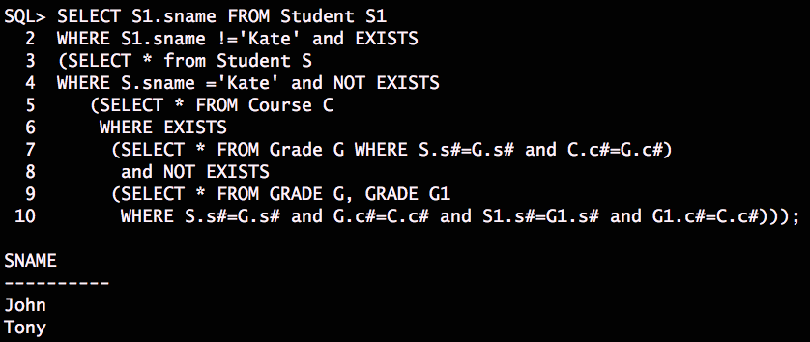
Execution Results
16. List the student names for students taking all courses that Kate takes
Method 1
Is there anyway to get rid of some EXISTS/NOT EXISTS

Slide 8
SQL Query Language
16. List the student names for students taking all courses that Kate takes
Method 2
SELECT S1.sname FROM Student S1, Student S
WHERE S1.sname!='Kate' and S.sname='Kate' and NOT EXISTS
( SELECT * FROM Course C
WHERE EXISTS
( SELECT * FROM Grade G
WHERE S.s#=G.s# and C.c#=G.c#)
and NOT EXISTS
( SELECT * FROM Grade G, Grade G1
WHERE S.s# = G.s# and G.c#=C.c#
and S1.s#=G1.s# and G1.c#=C.c#));

Slide 9
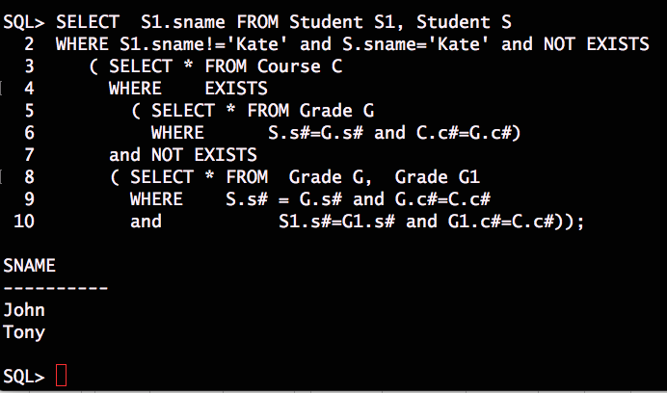
Execution Results
16. List the student names for students taking all courses that Kate takes
Method 2

Slide 10
SQL Query Language
16. List the student names for students taking all courses that Kate takes
SELECT S1.sname FROM Student S1, Student S
WHERE S1.sname!='Kate' and S.sname = 'Kate' and EXISTS
(SELECT * FROM Course C, Grade G, Grade G1
WHERE S.s# = G.s# and G.c#=C.c#
and S1.s#=G1.s# and G1.c#=C.c#);
This is the solution not using forall or not exists
All we care is the course that Kate takes.

Slide 11
SQL Query Language
16. List the student names for students taking all courses that Kate takes
Method 4 (flat)
SELECT S1.sname FROM Student S1, Student S2,
Grade G1, Grade G2, Course C
WHERE S1.sname!='Kate' and S2.sname = 'Kate'
and S2.s# = G2.s# and G2.c#=C.c#
and S1.s# = G1.s# and G1.c#=C.c#;
Note
This is the solution not using forall or not exists
All we care is the course that Kate takes.
Is it right?

Slide 12
SQL Query Language
16. List the student names for students taking all courses that Kate takes
Method 5
We need to find a set that contains the set of courses Kate takes
A contains B can be written as NOT EXISTS (B MINUS A)
B is the relation that contains c# that Kate takes
A is the relation that contains c# that a student other than Kate takes
This query is to find A that contains B

Slide 13
SQL Query Language
16. List the student names for students taking all courses that Kate takes
Method 5
SELECT S1.sname
FROM student S1
WHERE S1.sname!='Kate' and NOT EXISTS
( SELECT C.c#
FROM course C, student S, grade G
WHERE S.sname='Kate' and S.s#=G.s# and C.c#=G.c#
MINUS
SELECT C.c#
FROM course C, grade G
WHERE S1.s#=G.s# and C.c#=G.c#);
c# that Kate takes
c# that a student other than Kate takes

Slide 14
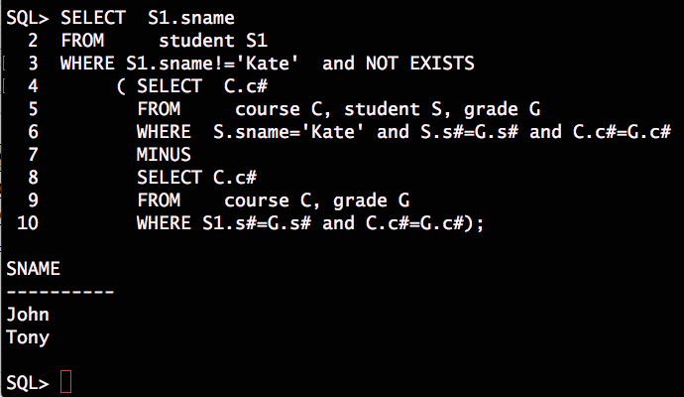
Execution Results
16. List the student names for students taking all courses that Kate takes
Method 5

Slide 15
Query Examples
17. List the student names for students taking only the courses that Kate takes
If Kate takes the course, then the student in the result also takes that course
{S1.sname | S1 in student and S1.sname != 'Kate' and
(exists S in student)(S.sname = 'Kate' and
(forall C in course)
(exists G in grade)(S.S#=G.S# and G.C#=C.C# and
(exists G1 in grade)(S1.S#=G1.S# and G1.C#=C.C#)) or
(not exists G in grade)(S.S#=G.S# and G.C#=C.C#) and
(not exists G1 in grade)(S1.S#=G1.S# and G1.C# =C'.C#))}
S’ for seeked students and S is for Kate
Kate takes it
S1 also takes it
Kate doesn’t take
S1 doesn’t take

Slide 16
Query Examples
17. List the student names for students taking only the courses that Kate takes
{S1.sname | S1 in student and S1.sname != 'Kate' and
(exists S in student)(S.sname = 'Kate' and
(forall C in course)
(exists G in grade)(S.S#=G.S# and G.C#=C.C# and
(exists G1 in grade)(S1.S#=G1.S# and G1.C#=C.C#))
or
(not exists G in grade)(S.S#=G.S# and G.C#=C.C#) and
(not exists G1 in grade)(S1.S#=G1.S# and G1.C# =C'.C#))};
{S1.sname | S1 in student and S1.sname != 'Kate' and
(exists S in student)(S.sname = 'Kate' and
(not exists C in course)
(not exists G in grade)(S.S#=G.S# and G.C#=C.C# or
(not exists G1 in grade)(S1.S#=G1.S# and G1.C#=C.C#))
and
(exists G in grade)(S.S#=G.S# and G.C#=C.C#) or
(exists G1 in grade)(S1.S#=G1.S# and G1.C# =C.C#))}
(forall C in Course)(F) ==(not exists C in Course) not (F)
not (A or B) == not A and not B
not (A and B) == not A or not B

Slide 17
Query Examples
17. List the student names for students taking only the courses that Kate takes
{S1.sname | S1 in student and S1.sname != 'Kate' and
(exists S in student)(S.sname = 'Kate' and
(not exists C in course)
(not exists G in grade)(S.S#=G.S# and G.C#=C.C# or
(not exists G1 in grade)(S1.S#=G1.S# and G1.C#=C.C#))
and
(exists G in grade)(S.S#=G.S# and G.C#=C.C#) or
(exists G1 in grade)(S1.S#=G1.S# and G1.C# =C.C#))}
SELECT S1.sname FROM Student S1, Student S
WHERE S1.sname!='Kate' and S.sname='Kate' and NOT EXISTS
( SELECT * FROM Course C WHERE NOT EXISTS
( SELECT * FROM Grade G, Grade G1
WHERE S.s# = G.s# and G.c#=C.c# and S1.s#=G1.s# and G1.c#=C.c#)
and EXISTS
( SELECT * FROM Grade G, Grade G1
WHERE (S.s#=G.s# and C.c#=G.c#) or (S1.s#=G1.s# and G1.c#=C.c#)));

Slide 18
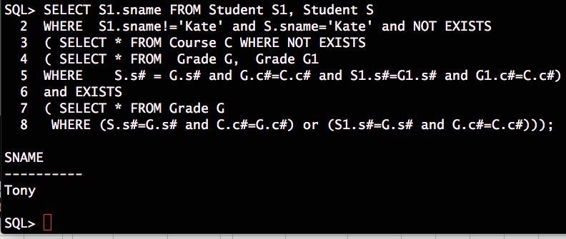
Execution Results
17. List the student names for students taking only the courses that Kate takes

Slide 19
Create Intermediate Table in SQL
Student |  |  |  | Grade |  |  |  | Course
S# | SNAME | AGE |  | S# | C# | MARK |  | C# | CNAME | LOC
1000 | John | 25 |  | 1000 | CS300 | 90 |  | CS300 | OS | ME300
2000 | Kate | 24 |  | 1000 | CS305 | 85 |  | CS305 | DB | UC231
3000 | Tony | 20 |  | 2000 | CS300 | 85 |  | MT230 | AL | TB300
T2 | A | B | C | D | E | F
 | 1000 | John | 25 | 1000 | CS300 | 90
 | 1000 | John | 25 | 1000 | CS305 | 85
 | 2000 | Kate | 24 | 2000 | CS300 | 85
CREATE TAMPORARY TABLE T2(A, B, C, D, E, F) AS
SELECT *
FROM student S, grade G;
Where S.S# = G.S#

Slide 20

Create Intermediate Table in SQL
Student1
S# | SNAME | AGE
1000 | John | 25
2000 | Kate | 24
Student2
S# | SNAME | AGE
2000 | Kate | 24
3000 | Tony | 20
Student
S# | SNAME | AGE
1000 | John | 25
2000 | Kate | 24
3000 | Tony | 20
create table Student1 as
select * from student where sname != 'Tony';
create table Student2 as
select * from student where sname != 'John';

Slide 21
SQL Query Language
Relational Algebra (ALG)
UNION, INTERSECT, MINUS
JOIN, OUTERJOIN
TIMES (Cartesian Product)
AGGREGATES
Tuple Relational Calculus (TRC)
{VA ₁, …, VA _{n} | Various Formulas } orderby …
Result
SELECT
Memberships
FROM
Other Formulas
WHERE
ORDERBY
GROUPBY

Slide 22
Algebra Operations in SQL: Intersect
Student1
S# | SNAME | AGE
1000 | John | 25
2000 | Kate | 24
Student2
S# | SNAME | AGE
2000 | Kate | 24
3000 | Tony | 20
Student1 intersect Student2
S# | SNAME | AGE
2000 | Kate | 24
{S.* | S in Student1 and S in Student2};
select S.*
from student1 S, student2 S;
Not supported
ORA-00918: column ambiguously defined
select * from student1
intersection
select * from student2;

Slide 23
Algebra Operations in SQL: Union
Student1
S# | SNAME | AGE
1000 | John | 25
2000 | Kate | 24
Student2
S# | SNAME | AGE
2000 | Kate | 24
3000 | Tony | 20
Student1 union Student2
S# | SNAME | AGE
1000 | John | 25
2000 | Kate | 24
3000 | Tony | 20
{S.* | S in Student1 or S in Student2};
select * from Student1
union
select * from Student2;

Slide 24
Algebra Operations in SQL:Minus
Student1
S# | SNAME | AGE
1000 | John | 25
2000 | Kate | 24
Student2
S# | SNAME | AGE
2000 | Kate | 24
3000 | Tony | 20
Student1 minus Student2
S# | SNAME | AGE
1000 | John | 25
{S.* | S in Student1 and not S in Student2};
select * from student1
minus
select * from student2;

Slide 25
Join in SQL
EQUIL JOIN
NATURAL JOIN
OUTER JOIN
LEFT OUTER JOIN
RIGHT OUTER JOIN
FULL OUTER JOIN

Slide 26
EQUIJOIN in SQL
Student |  |  |  | Grade |  |  |  | Course
S# | SNAME | AGE |  | S# | C# | MARK |  | C# | CNAME | LOC
1000 | John | 25 |  | 1000 | CS300 | 90 |  | CS300 | OS | ME300
2000 | Kate | 24 |  | 1000 | CS305 | 85 |  | CS305 | DB | UC231
3000 | Tony | 20 |  | 2000 | CS300 | 85 |  | MT230 | AL | TB300
SELECT *
FROM student s, grade g
WHERE s.s# = g.s#;
EQUIJOIN
SELECT *
FROM student JOIN grade USING (S#);

Slide 27
EQUIJOIN in SQL
Student |  |  |  | Grade |  |  |  | Course
S# | SNAME | AGE |  | S# | C# | MARK |  | C# | CNAME | LOC
1000 | John | 25 |  | 1000 | CS300 | 90 |  | CS300 | OS | ME300
2000 | Kate | 24 |  | 1000 | CS305 | 85 |  | CS305 | DB | UC231
3000 | Tony | 20 |  | 2000 | CS300 | 85 |  | MT230 | AL | TB300
SELECT *
FROM student s, grade g, course c
WHERE s.s# = g.s# AND g.c# = c.c#;
SELECT *
FROM student JOIN grade USING (s#)
JOIN course USING (c#);

Slide 28
NATURAL JOIN in SQL
Student |  |  |  | Grade |  |  |  | Course
S# | SNAME | AGE |  | S# | C# | MARK |  | C# | CNAME | LOC
1000 | John | 25 |  | 1000 | CS300 | 90 |  | CS300 | OS | ME300
2000 | Kate | 24 |  | 1000 | CS305 | 85 |  | CS305 | DB | UC231
3000 | Tony | 20 |  | 2000 | CS300 | 85 |  | MT230 | AL | TB300
SELECT *
FROM student s, grade g
WHERE s.s# = g.s#;
SELECT *
FROM student NATURAL JOIN grade;

Slide 29
NATURAL JOIN in SQL
Student |  |  |  | Grade |  |  |  | Course
S# | SNAME | AGE |  | S# | C# | MARK |  | C# | CNAME | LOC
1000 | John | 25 |  | 1000 | CS300 | 90 |  | CS300 | OS | ME300
2000 | Kate | 24 |  | 1000 | CS305 | 85 |  | CS305 | DB | UC231
3000 | Tony | 20 |  | 2000 | CS300 | 85 |  | MT230 | AL | TB300
SELECT *
FROM student s, grade g, course c
WHERE s.s# = g.s# AND g.c# = c.c#;
SELECT *
FROM student NATURAL JOIN grade g
NATURAL JOIN course;

Slide 30
OUTER JOIN in SQL
LEFT OUTER JOIN
RIGHT OUTER JOIN
FULL OUTER JOIN
NATURAL LEFT OUTER JOIN
NATURAL LRIGHT OUTER JOIN
NATURAL FULL OUTER JOIN

Slide 31
LEFT OUTER JOIN in SQL
Student |  |  |  | Grade |  |  |  | Course
S# | SNAME | AGE |  | S# | C# | MARK |  | C# | CNAME | LOC
1000 | John | 25 |  | 1000 | CS300 | 90 |  | CS300 | OS | ME300
2000 | Kate | 24 |  | 1000 | CS305 | 85 |  | CS305 | DB | UC231
3000 | Tony | 20 |  | 2000 | CS300 | 85 |  | MT230 | AL | TB300
SELECT *
FROM student LEFT OUTER JOIN grade USING (S#);
S# | SNAME | AGE | S# | C# | MARK
1000 | John | 25 | 1000 | CS300 | 90
1000 | John | 25 | 1000 | CS305 | 85
2000 | Kate | 24 | 2000 | CS300 | 85
3000 | Tony | 20

Slide 32
RIGHT OUTER JOIN in SQL
Student |  |  |  | Grade |  |  |  | Course
S# | SNAME | AGE |  | S# | C# | MARK |  | C# | CNAME | LOC
1000 | John | 25 |  | 1000 | CS300 | 90 |  | CS300 | OS | ME300
2000 | Kate | 24 |  | 1000 | CS305 | 85 |  | CS305 | DB | UC231
3000 | Tony | 20 |  | 2000 | CS300 | 85 |  | MT230 | AL | TB300
SELECT *
FROM grade RIGHT OUTER JOIN course USING (C#);
S# | C# | MARK | C# | CNAME | LOC
1000 | CS300 | 90 | CS300 | OS | ME300
1000 | CS305 | 85 | CS305 | DB | UC231
2000 | CS300 | 85 | CS300 | OS | ME300
 |  |  | MT230 | AL | TB300

Slide 33
FULL OUTER JOIN in SQL
Student |  |  |  | Grade |  |  |  | Course
S# | SNAME | AGE |  | S# | C# | MARK |  | C# | CNAME | LOC
1000 | John | 25 |  | 1000 | CS300 | 90 |  | CS300 | OS | ME300
2000 | Kate | 24 |  | 1000 | CS305 | 85 |  | CS305 | DB | UC231
3000 | Tony | 20 |  | 2000 | CS300 | 85 |  | MT230 | AL | TB300
SELECT *
FROM student FULL OUTER JOIN grade USING (S#)
FULL OUTER JOIN course using (C#);
S# | SNAME | AGE | S# | C# | MARK | C# | CNAME | LOC
1000 | John | 25 | 1000 | CS300 | 90 | CS300 | OS | ME300
1000 | John | 25 | 1000 | CS305 | 85 | CS305 | DB | UC231
2000 | Kate | 24 | 2000 | CS300 | 85 | CS300 | OS | ME300
3000 | Tony | 20
 |  |  |  |  |  | MT230 | AL | TB300

Slide 34
NATURAL LEFT OUTER JOIN in SQL
Student |  |  |  | Grade |  |  |  | Course
S# | SNAME | AGE |  | S# | C# | MARK |  | C# | CNAME | LOC
1000 | John | 25 |  | 1000 | CS300 | 90 |  | CS300 | OS | ME300
2000 | Kate | 24 |  | 1000 | CS305 | 85 |  | CS305 | DB | UC231
3000 | Tony | 20 |  | 2000 | CS300 | 85 |  | MT230 | AL | TB300
SELECT *
FROM student NATURAL LEFT OUTER JOIN grade;
S# | SNAME | AGE | C# | MARK
1000 | John | 25 | CS300 | 90
1000 | John | 25 | CS305 | 85
2000 | Kate | 24 | CS300 | 85
3000 | Tony | 20

Slide 35
NATURAL RIGHT OUTER JOIN in SQL
Student |  |  |  | Grade |  |  |  | Course
S# | SNAME | AGE |  | S# | C# | MARK |  | C# | CNAME | LOC
1000 | John | 25 |  | 1000 | CS300 | 90 |  | CS300 | OS | ME300
2000 | Kate | 24 |  | 1000 | CS305 | 85 |  | CS305 | DB | UC231
3000 | Tony | 20 |  | 2000 | CS300 | 85 |  | MT230 | AL | TB300
SELECT *
FROM grade NATURAL RIGHT OUTER JOIN course;
S# | MARK | C# | CNAME | LOC
1000 | 90 | CS300 | OS | ME300
1000 | 85 | CS305 | DB | UC231
2000 | 85 | CS300 | OS | ME300
 |  | MT230 | AL | TB300

Slide 36
NATURAL FULL OUTER JOIN in SQL
Student |  |  |  | Grade |  |  |  | Course
S# | SNAME | AGE |  | S# | C# | MARK |  | C# | CNAME | LOC
1000 | John | 25 |  | 1000 | CS300 | 90 |  | CS300 | OS | ME300
2000 | Kate | 24 |  | 1000 | CS305 | 85 |  | CS305 | DB | UC231
3000 | Tony | 20 |  | 2000 | CS300 | 85 |  | MT230 | AL | TB300
SELECT *
FROM student NATURAL FULL OUTER JOIN grade
NATURAL FULL OUTER JOIN course;
S# | SNAME | AGE | MARK | C# | CNAME | LOC
1000 | John | 25 | 90 | CS300 | OS | ME300
1000 | John | 25 | 85 | CS305 | DB | UC231
2000 | Kate | 24 | 85 | CS300 | OS | ME300
3000 | Tony | 20
 |  |  |  | MT230 | AL | TB300

Slide 37
TIMES in SQL
Student |  |  |  | Grade |  |  |  | Course
S# | SNAME | AGE |  | S# | C# | MARK |  | C# | CNAME | LOC
1000 | John | 25 |  | 1000 | CS300 | 90 |  | CS300 | OS | ME300
2000 | Kate | 24 |  | 1000 | CS305 | 85 |  | CS305 | DB | UC231
3000 | Tony | 20 |  | 2000 | CS300 | 85 |  | MT230 | AL | TB300
SELECT S.sname, C.cname
FROM student S CROSS JOIN course C;
SELECT S.sname, C.cname
FROM student S CROSS JOIN course C
WHERE NOT EXISTS
( SELECT *
FROM grade G
WHERE S.S# = G.S# and G.C# = C.C#);

Slide 38
ARITHMETIC OPERATIONS
The standard arithmetic operators '+', '-'. '*', and '/' (for addition, subtraction, multiplication, and division, respectively) can be applied to numeric values in an SQL query result
Show the effect of giving every student in CS305 10% mark increase
SELECT S#, C#, 1.1*Mark
FROM grade
WHERE c#= 'CS305';

Slide 39
SQL Query Language
SELECT [DISTINCT] items
attribute names whose values are to be retrieved by the query
FROM tables
list of the relation names required to process the query
[WHERE conditions]
conditions on tuples
[GROUP BY columns]
for min, max, count, total, average on groups
[HAVING condition]
conditions on grouping
[ORDER BY columns]
sorting the result DESC|ASC

Slide 40
Aggregate Functions in SQL
Used to summarize information from multiple tuples into a single-tuple summary
Built-in aggregate functions
COUNT, SUM, MAX, MIN, and AVG
Grouping
Create subgroups of tuples before summarizing
To select entire groups, HAVING clause is used
Aggregate functions can be used in the SELECT clause or in a HAVING clause

Slide 41
Aggregate Functions in SQL
Student |  |  |  | Grade |  |  |  | Course
S# | SNAME | AGE |  | S# | C# | MARK |  | C# | CNAME | LOC
1000 | John | 25 |  | 1000 | CS300 | 90 |  | CS300 | OS | ME300
2000 | Kate | 24 |  | 1000 | CS305 | 85 |  | CS305 | DB | UC231
3000 | Tony | 20 |  | 2000 | CS300 | 85 |  | MT230 | AL | TB300
Find the average mark of all courses
select avg(mark)
from grade;
Find the maximum mark value for CS300
select max(mark)
from grade
where C#='CS300’;

Slide 42
Aggregate Functions in SQL
Student |  |  |  | Grade |  |  |  | Course
S# | SNAME | AGE |  | S# | C# | MARK |  | C# | CNAME | LOC
1000 | John | 25 |  | 1000 | CS300 | 90 |  | CS300 | OS | ME300
2000 | Kate | 24 |  | 1000 | CS305 | 85 |  | CS305 | DB | UC231
3000 | Tony | 20 |  | 2000 | CS300 | 85 |  | MT230 | AL | TB300
Find the number of students and their average age
select count(*), avg(age)
from student;

Slide 43
Aggregate Functions in SQL
Student |  |  |  | Grade |  |  |  | Course
S# | SNAME | AGE |  | S# | C# | MARK |  | C# | CNAME | LOC
1000 | John | 25 |  | 1000 | CS300 | 90 |  | CS300 | OS | ME300
2000 | Kate | 24 |  | 1000 | CS305 | 85 |  | CS305 | DB | UC231
3000 | Tony | 20 |  | 2000 | CS300 | 85 |  | MT230 | AL | TB300
List the student number and the number of courses the student takes
select S#, count(*)
from Grade
group by S#;

Slide 44
Aggregate Functions in SQL
Student |  |  |  | Grade |  |  |  | Course
S# | SNAME | AGE |  | S# | C# | MARK |  | C# | CNAME | LOC
1000 | John | 25 |  | 1000 | CS300 | 90 |  | CS300 | OS | ME300
2000 | Kate | 24 |  | 1000 | CS305 | 85 |  | CS305 | DB | UC231
3000 | Tony | 20 |  | 2000 | CS300 | 85 |  | MT230 | AL | TB300
List the student names for students taking more than one course
select sname
from Student natural Join Grade
group by sname
having count(*) > 1;

Slide 45
Aggregate Functions in SQL
Student |  |  |  | Grade |  |  |  | Course
S# | SNAME | AGE |  | S# | C# | MARK |  | C# | CNAME | LOC
1000 | John | 25 |  | 1000 | CS300 | 90 |  | CS300 | OS | ME300
2000 | Kate | 24 |  | 1000 | CS305 | 85 |  | CS305 | DB | UC231
3000 | Tony | 20 |  | 2000 | CS300 | 85 |  | MT230 | AL | TB300
List the course names for courses with average mark more than 80
select cname
from Course natural join Grade
group by cname
having avg(mark) > 80;

Slide 46
ORDER BY
The ORDER BY clause is used to sort the tuples in a query result based on the values of some attribute(s)
SELECT *
FROM student NATURAL FULL OUTER JOIN grade
NATURAL FULL OUTER JOIN course
ORDER BY sname ASC;
The default order is in ascending order of values
The keyword DESC is for a descending order; the keyword ASC is for an ascending order, and is the default

